Slide 1


WORD EMBEDDING
Team Members:
Abhiraj Thakur: 20BCS6802

Slide 2

About Natural Language Processing
Natural Language Processing (NLP) is a subfield of artificial intelligence (AI) that focuses on enabling computers to understand, interpret, and generate human language. It involves the development of algorithms and computational models that can analyze and process human language data, such as text, speech, and images.
NLP is used in a wide range of applications, including text classification, sentiment analysis, language translation, chatbots, and speech recognition. The technology has been used in industries such as healthcare, finance, and customer service, among others, to automate processes, improve customer experiences, and gain insights from large volumes of language data.
Back to Agenda

Slide 3
Techniques used in NLP
1 | Tokenization:-This involves breaking down a piece of text into smaller units, such as words or phrases, in order to analyze it more easily.
2 | Part-of-speech tagging: This involves labeling each word in a sentence with its part of speech (e.g., noun, verb, adjective), which can help in tasks like text classification and sentiment analysis.
3 | Named entity recognition: This involves identifying and extracting named entities (such as people, places, and organizations) from text.
4 | Parsing: This involves analyzing the grammatical structure of a sentence to understand its meaning.
5 | Sentiment analysis: This involves analyzing text to determine the writer's attitude or emotional state.
6 | Machine translation: This involves translating text from one language to another.

Slide 4
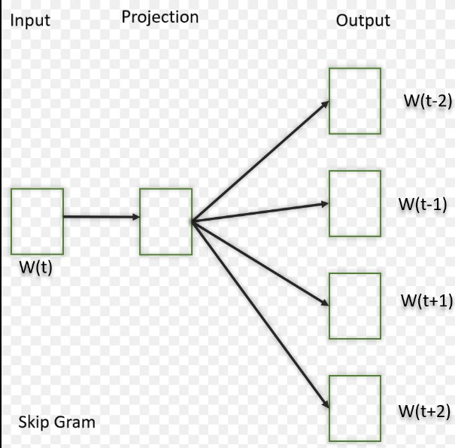
WHAT IS WORD EMBEDDING
It is an approach for representing words and documents. Word Embedding or Word Vector is a numeric vector input that represents a word in a lower- dimensional space. It allows words with similar meaning to have a similar representation.
They can also approximate meaning. A word vector with 50 values can represent 50 unique features.

Slide 5
What is Preprocessing
Preprocessing in NLP (Natural Language Processing) refers to the cleaning, transforming, and organizing of raw textual data before it can be used for various NLP tasks such as text classification, sentiment analysis, machine translation, and others.
Preprocessing is an essential step in NLP, as it helps to reduce noise and irrelevant information in the data, and to extract useful features that can be used to improve the accuracy of NLP models.
Preprocessing in NLP typically involves several steps such as text cleaning, tokenization, stop word removal, stemming or lemmatization, part-of-speech tagging, named entity recognition, dependency parsing, and chunking, among others.
Back to Agenda

Slide 6
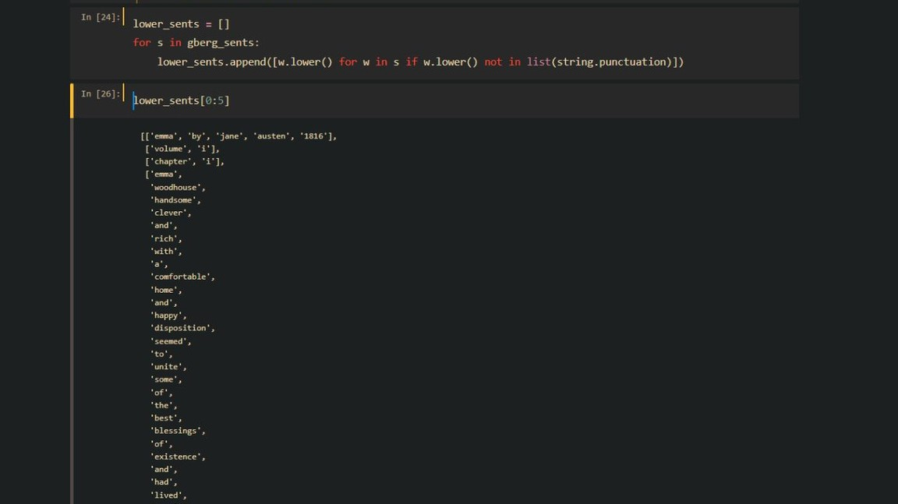
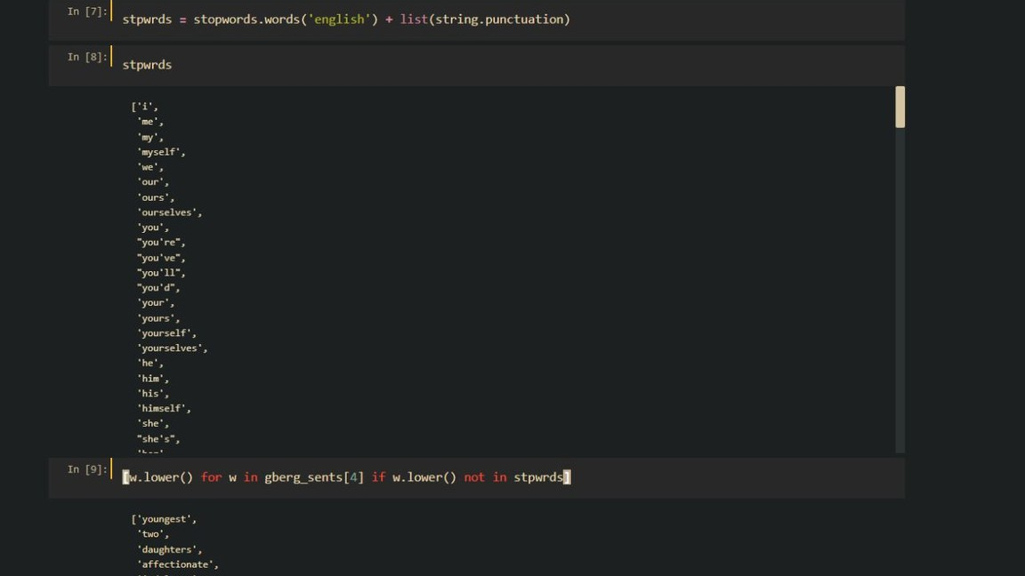
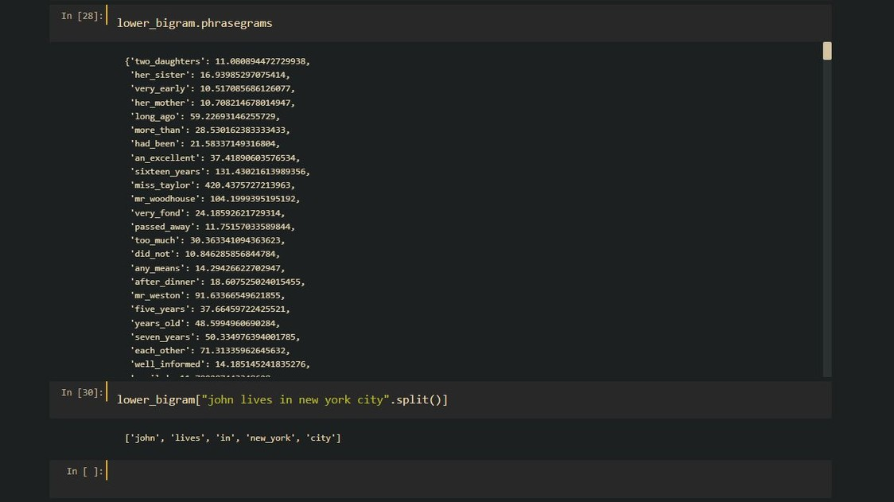
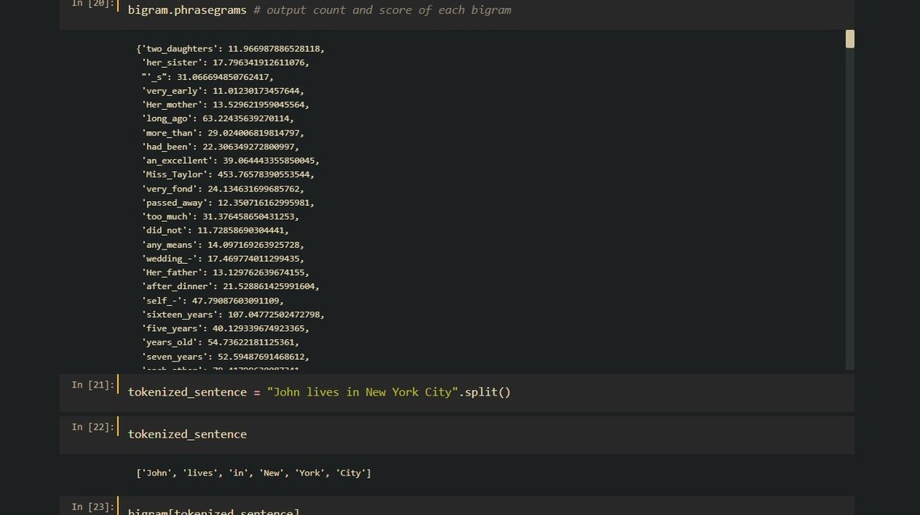
Preprocessing
Drag and drop your photo or video! Click the sample photo or video and delete.
Select yours from the uploads tab, drag, and then drop inside the frame!

Slide 7
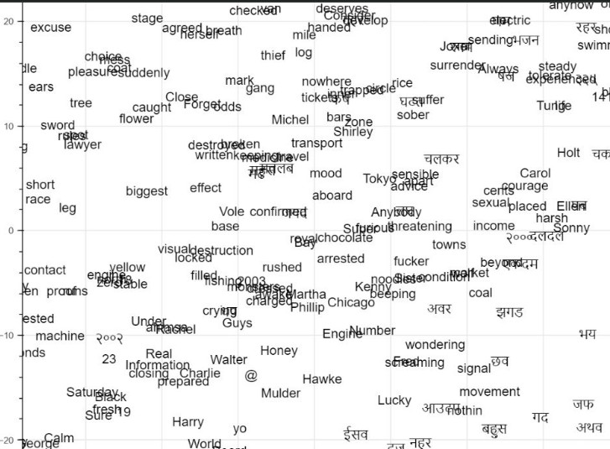
Word to Vector
Word to vector (Word2Vec) is an algorithm for word embedding in NLP.
Word2Vec represents words as numerical vectors in a high-dimensional space.
Word2Vec uses a neural network to predict the context words of a target word.
Word2Vec is trained on large amounts of text data and captures the semantic meaning of words.
Back to Agenda

Slide 8

Vec Map
1 | It aligns the word embeddings of two different languages by finding a mapping between their vector spaces.
2 | It uses a set of known word translations to train a linear transformation matrix between the embedding spaces.
3 | The transformation matrix is used to map the embedding vectors of all the words in each language to the other language's embedding space.
4 | This allows for the alignment of the embedding spaces of the two languages and enables cross-lingual transfer of knowledge.
5 | VecMap is a powerful technique for cross-lingual NLP, as it does not require parallel data or expensive training of separate models for each language.
6 | It has been used in various applications, such as machine translation, cross-lingual document classification, and cross-lingual named entity recognition, among others.
VecMap is a technique used in natural language processing (NLP) for cross- lingual word embedding mapping, which is the process of aligning the word embeddings of two different languages. The goal of VecMap is to find a mapping between the vector spaces of two languages, such that the embedding vectors of the same word in each language are aligned.

Slide 9
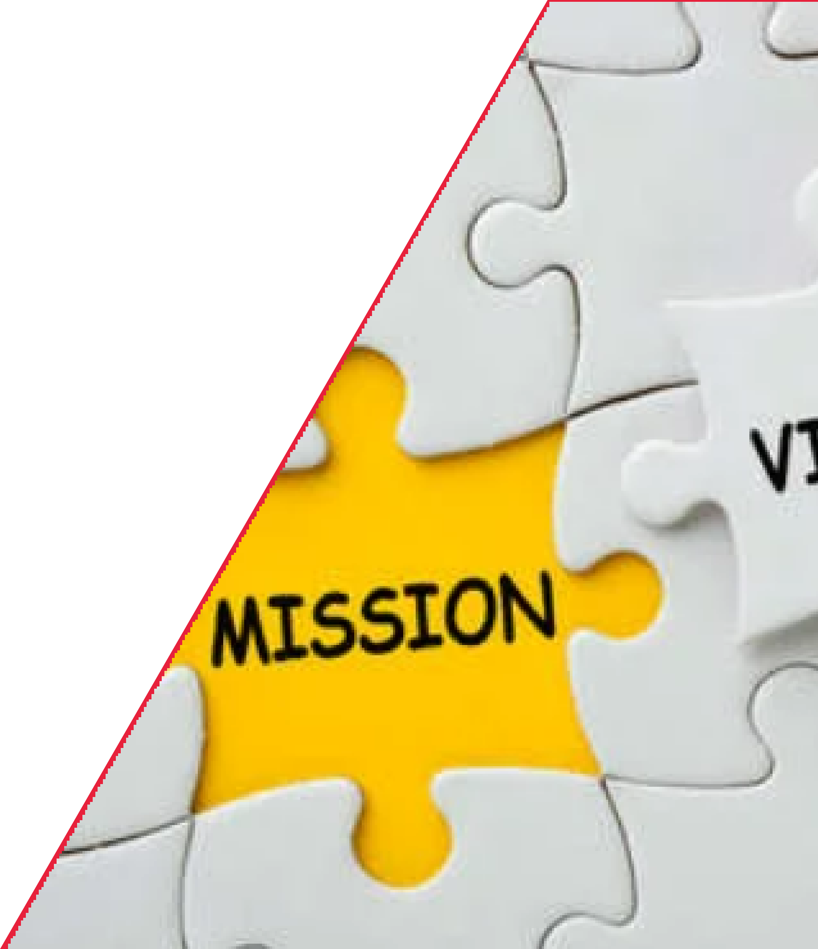
Our Mission and Vision
Mission
Vision
Embedded systems in NLP aim to enable efficient and effective natural language processing in various applications.
The vision of embedded systems in NLP is to enable seamless and natural interactions between humans and machines through natural language.
Back to Agenda

Slide 10
Thank you

